Slide 1
Project IV
Final Presentation
Jack Fennell C00220386

Slide 2
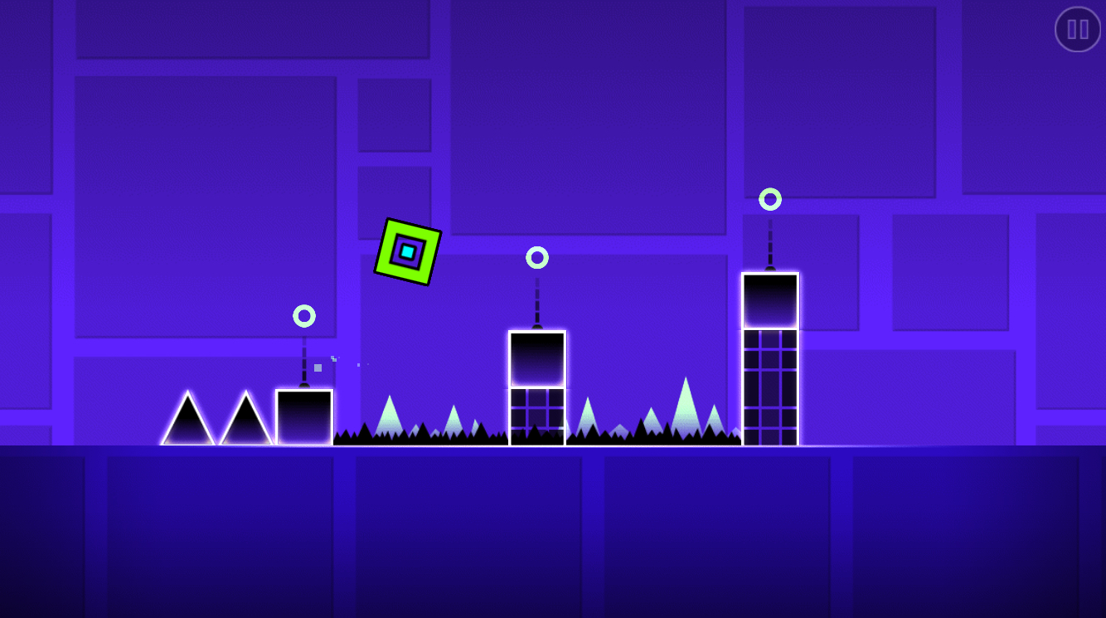
Introduction
Develop and train an Artificial Neural Network to play Geometry Dash.
Training the neural network using Backpropagation and Genetic Algorithms.
Supervised Learning.

Slide 3
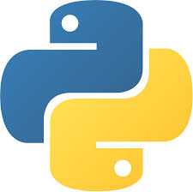

Software/Hardware Used
Python 3.6.5.
Visual Studio Code.
TensorFlow Library. (Neural network library)
TF Learn(Similar to Keras)
Arcade Library. (2D game library for Python)

Slide 4
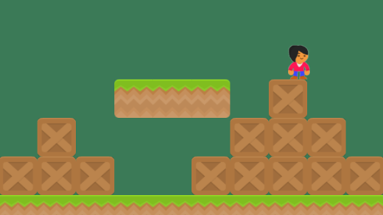
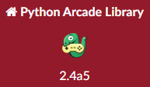
Arcade Library
Arcade library is a Python library for creating 2D games.
It has a built in physics engine for platformers. i.e Geometry Dash.
Lots of easy to understand documentation and examples.
Used in the creation of the Geometry Dash game.

Slide 5

TFLearn
Is built upon the Tensorflow library and is similar to Keras.
It makes creating and using, training and developing neural networks easy and quite simple.
Used in the creation of the neural network to play Geometry Dash.

Slide 6
Research
Artificial Neural networks - An artificial brain which takes input data and traverses hidden layers of learning to arrive at the output.
Backpropagation - Takes the output data and goes backwards through the layers of the ANN to arrive and an input adjusting values in the hidden layers
Genetic Algorithm - Trains the input with randomised values for weights and takes the best values closest to the output and passes them to next iteration.

Slide 7
Neural network Design
Inputs (3)
Hidden Layer (32)
Output (1)
Characters X Position
Fully Connected
Hidden
Value
1
Fully Connected
Jump-1
Don’t Jump-0
Characters Y
Position
Hidden
Value
32
Closet Obstacle X Position

Slide 8
Results
Recreated the Geometry Dash Game minus some complexity with the obstacles.
Designed, developed and train a ANN with the help of TFLearn an extension of Tensorflow.
Learned how to code in Python libraries, Arcade and TFLearn.
No Genetic Algorithm or Backpropagation implemented to play game.

Slide 9
Conclusions
Not enough work was done with the Genetic Algorithm or the Backpropagation.
No Complexity to the Geometry Dash game.
Project developed only has a game that captures data from playing and trains the neural network designed in TFLearn.

Slide 10

Video

Slide 11

Questions

